Slide 1

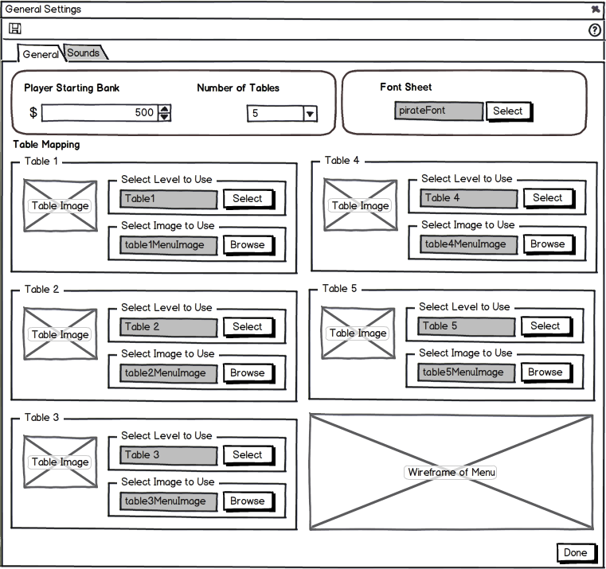
General Settings 1
760x715

Slide 2
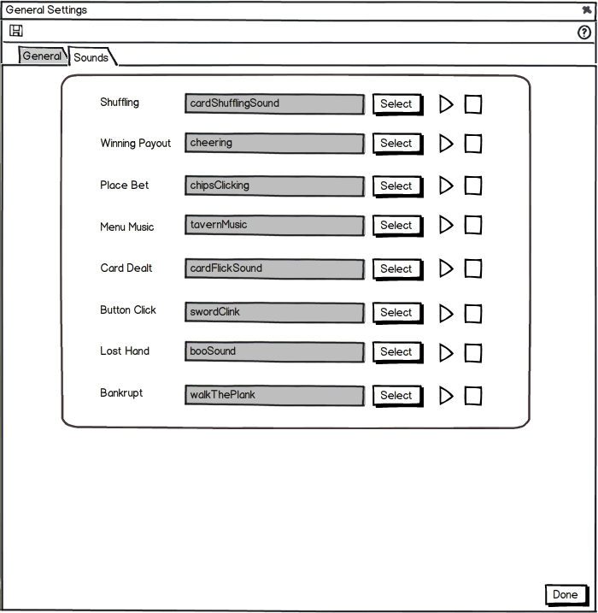
General Settings 2
760x715

Slide 3
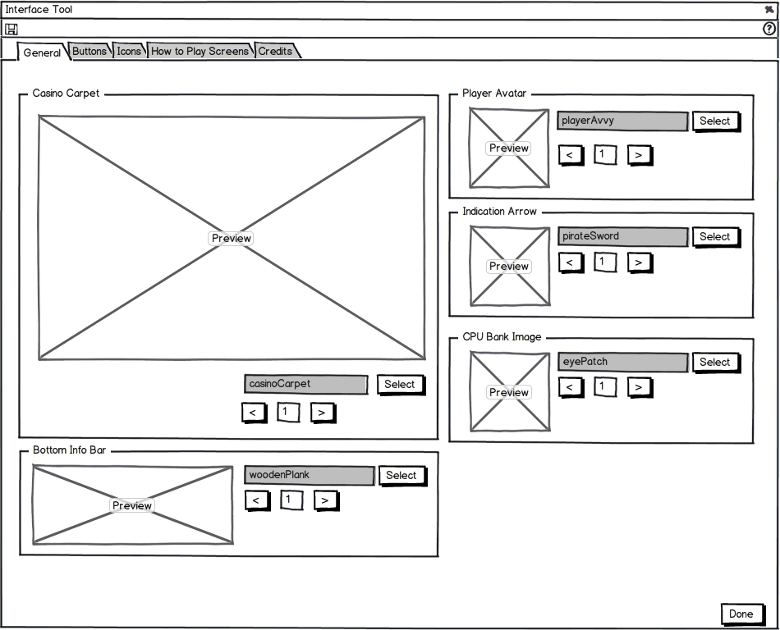
Interface Tool 1 - General
950x770

Slide 4
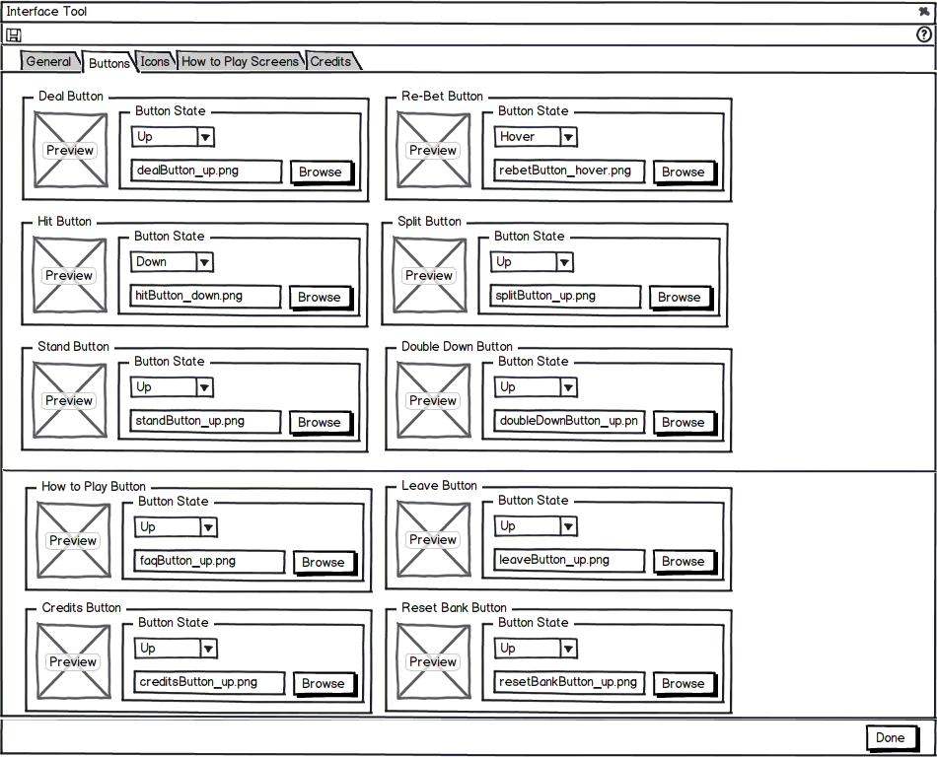
Interface Tool - Buttons
950x770
Notes:
Filepath should just show the name of the asset (myButton.png)

Slide 5
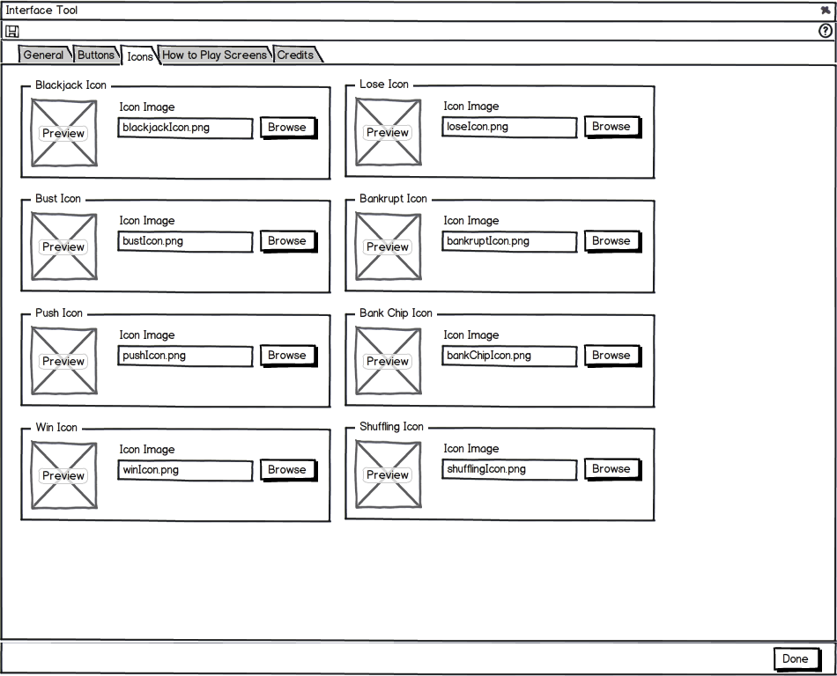
Interface Tool - Icons
950x770
Notes:
Remove the filepath next to the browse button. (Possibly but some text on what they are browsing for)

Slide 6
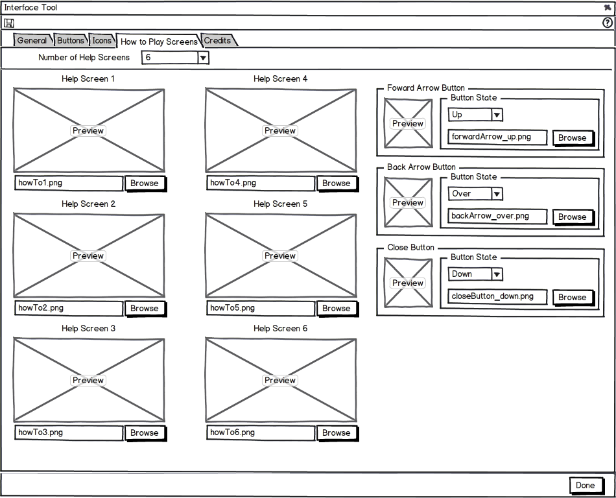
Interface Tool - How to Play Screens
950x770

Slide 7
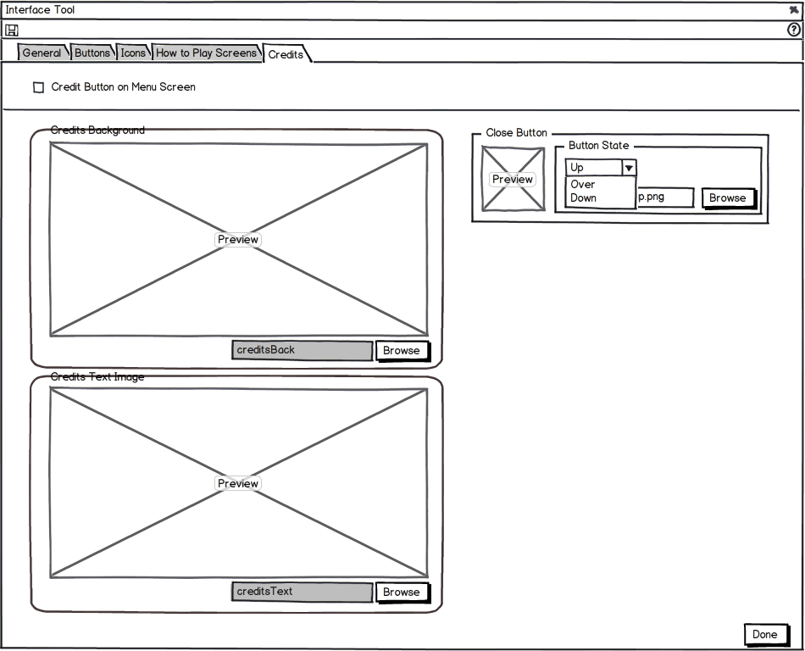
Interface Tool - Credits
950x770
Notes:
“Close Button” should be a browse not a select
Are the other pieces supposed to be selects or browse

Slide 8
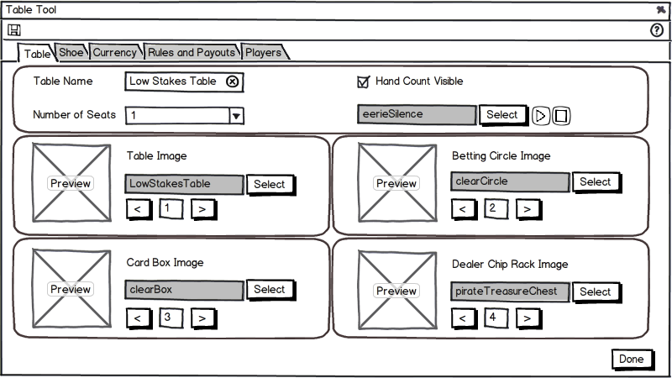
Table Tool - Table
800x450

Slide 9
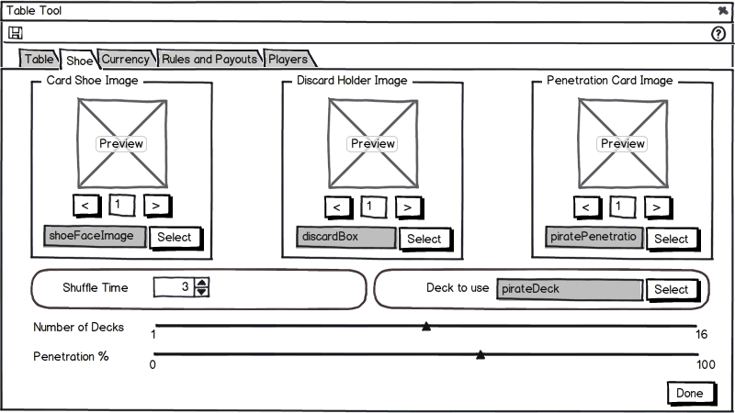
Table Tool - Shoe
800x450

Slide 10
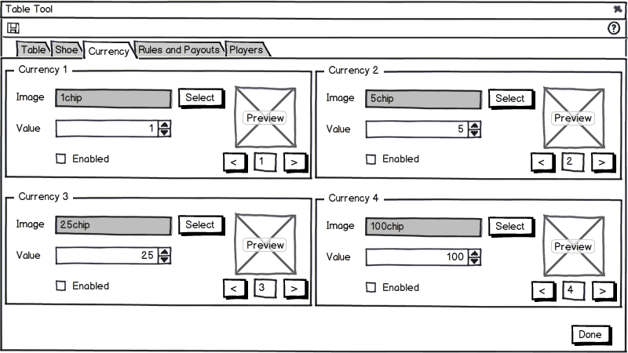
Table Tool - Currency
800x450

Slide 11
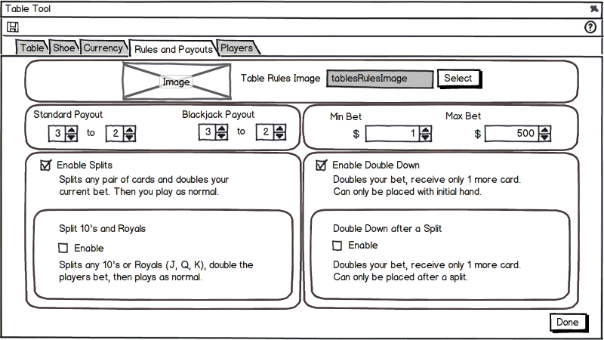
Table Tool – Rules
800x450

Slide 12
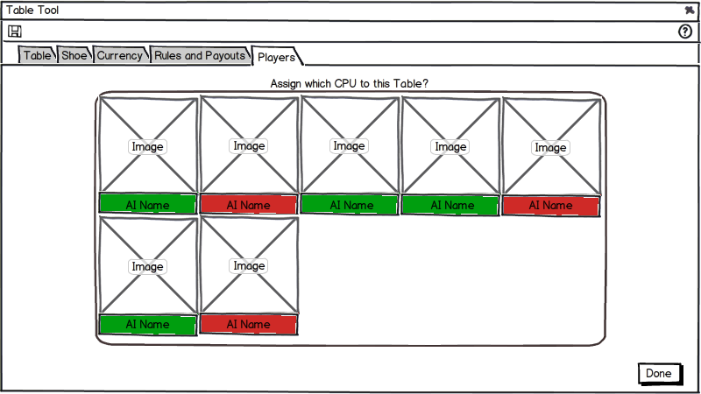
Table Tool - Players
800x450

Slide 13
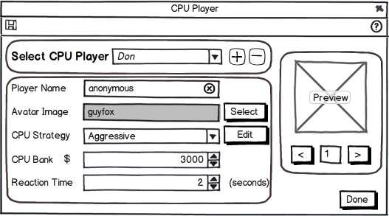
CPU Player Editor
530x330

Slide 14
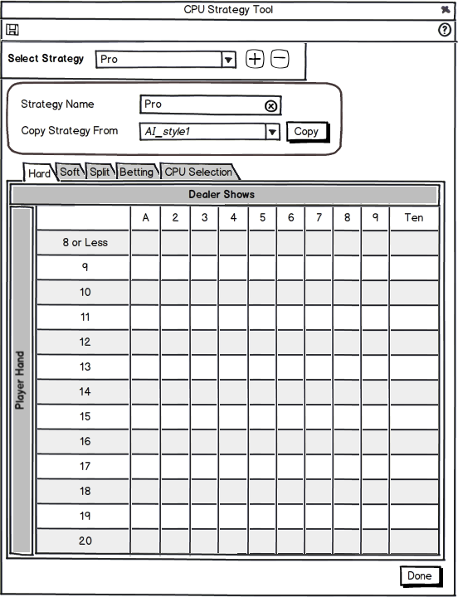
CPU Strategy Tool - Hard
550x720

Slide 15
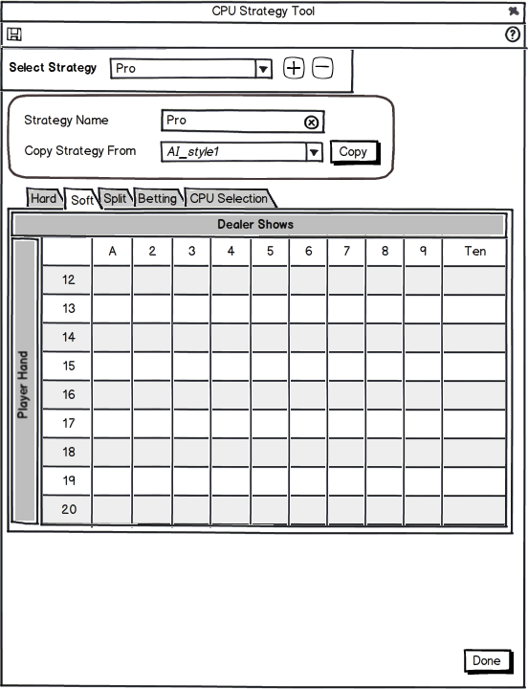
CPU Strategy Tool - Soft
550x720

Slide 16
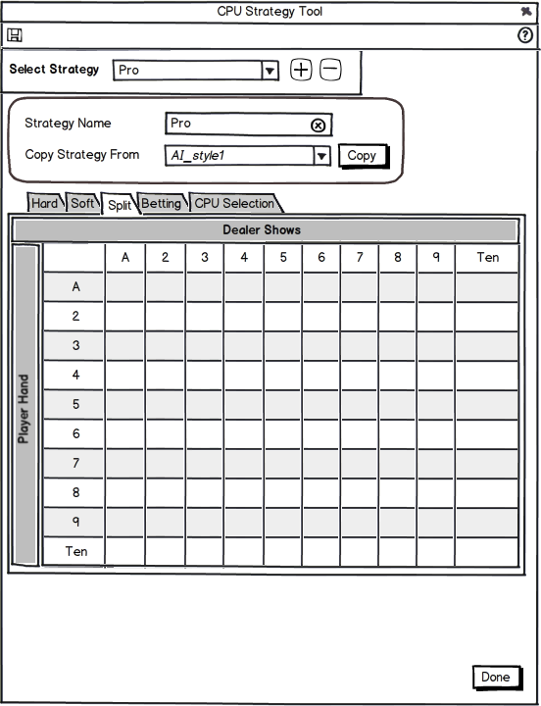
CPU Strategy Tool – Split
550x720

Slide 17
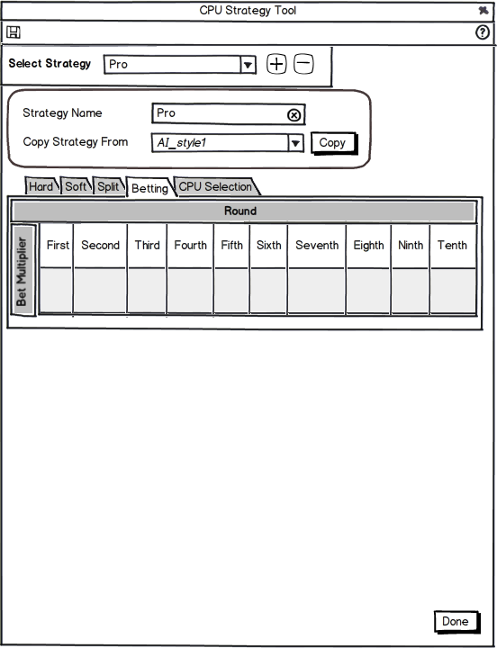
CPU Strategy Tool - Betting
550x720

Slide 18
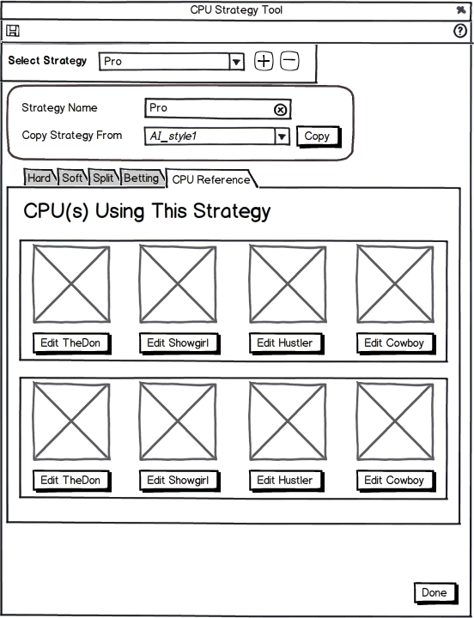
CPU Strategy Tool – CPU Reference
550x720

Slide 19
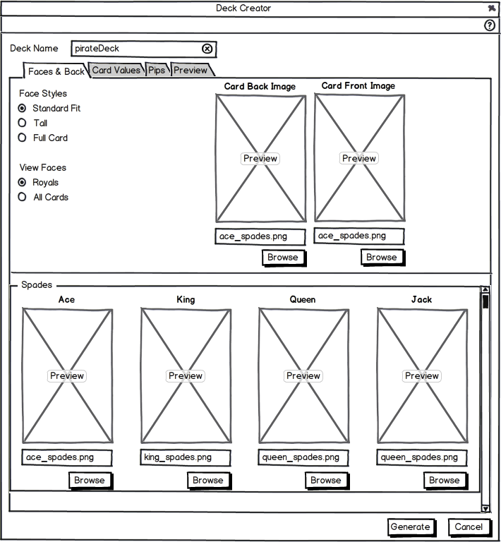

Deck Creator 1
710x768

Slide 20
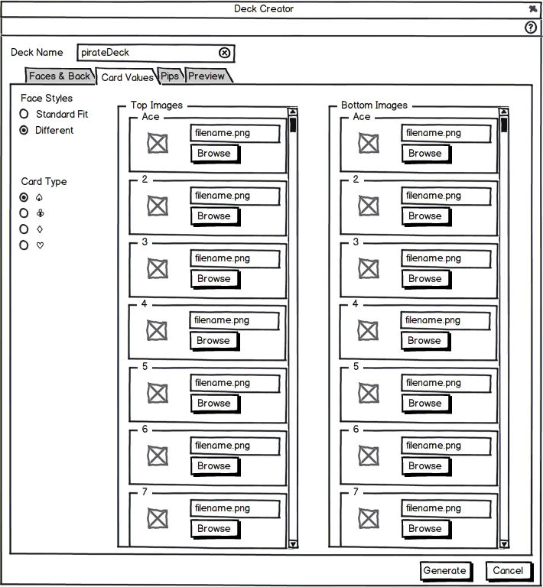
Deck Creator 2
710x768

Slide 21
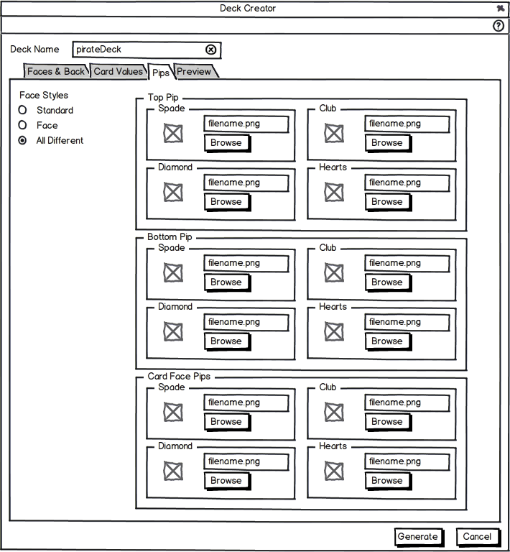
Deck Creator 3
710x768

Slide 22
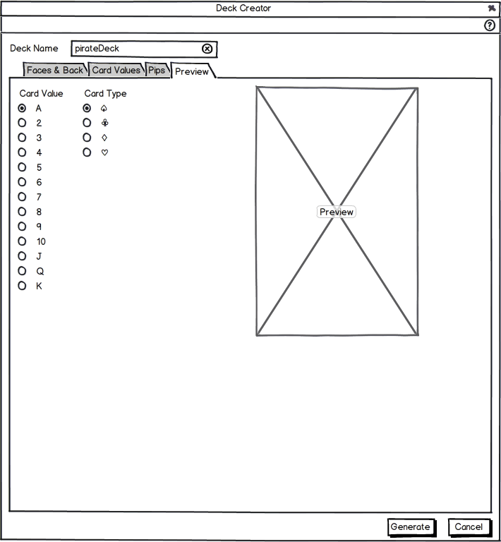
Deck Creator 4
710x768

